Slide 1

CCPS 506
Comparative Programming Languages
Fall 2019
Lecture #1

Slide 2

Instructor
Alex Ufkes
aufkes@ryerson.ca
Class times:
Sat: 9:00 – 12:00pm
Sat: 12:00 – 1:00pm (Lab)
Office hour:
During lab/after class, by appointment

Slide 3
When Contacting…
E-mail – I check it often (aufkes@ryerson.ca)
Please put CCPS506 in the subject line
Include your full name
Use your Ryerson account

Slide 4
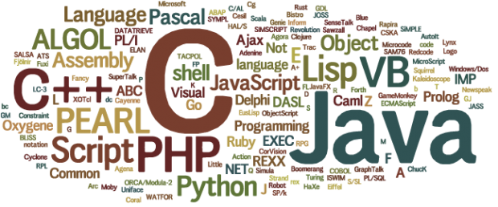
You
Passed (C)CPS 109, 209
?

Slide 5
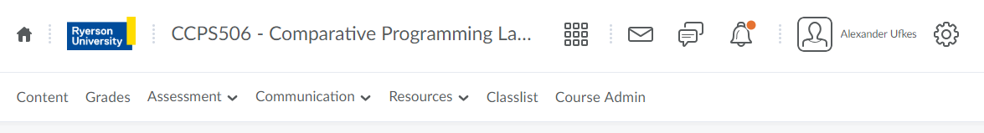
Course Administration
Announcements related to this course will be made on D2L. Be sure to check regularly!
Grades, assignments, and labs will be posted to D2L.
The course outline can also be found there.

Slide 6
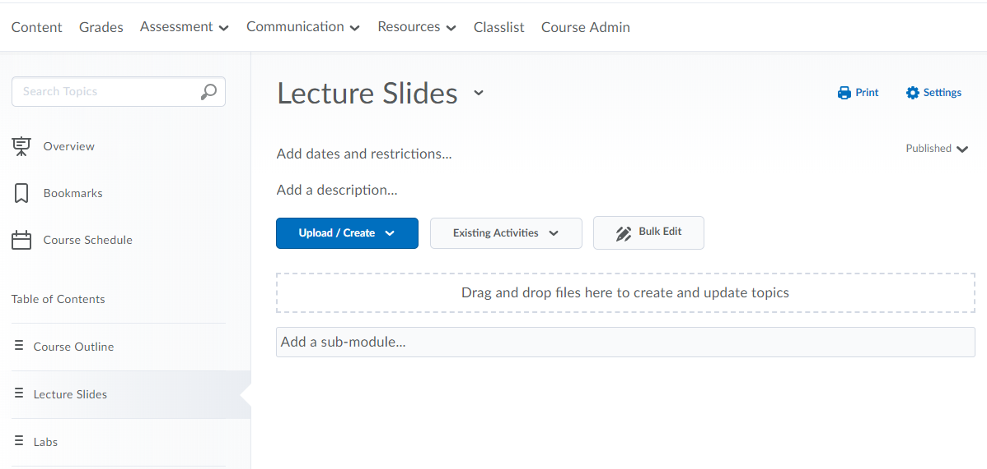
D2L Course Content

Slide 7
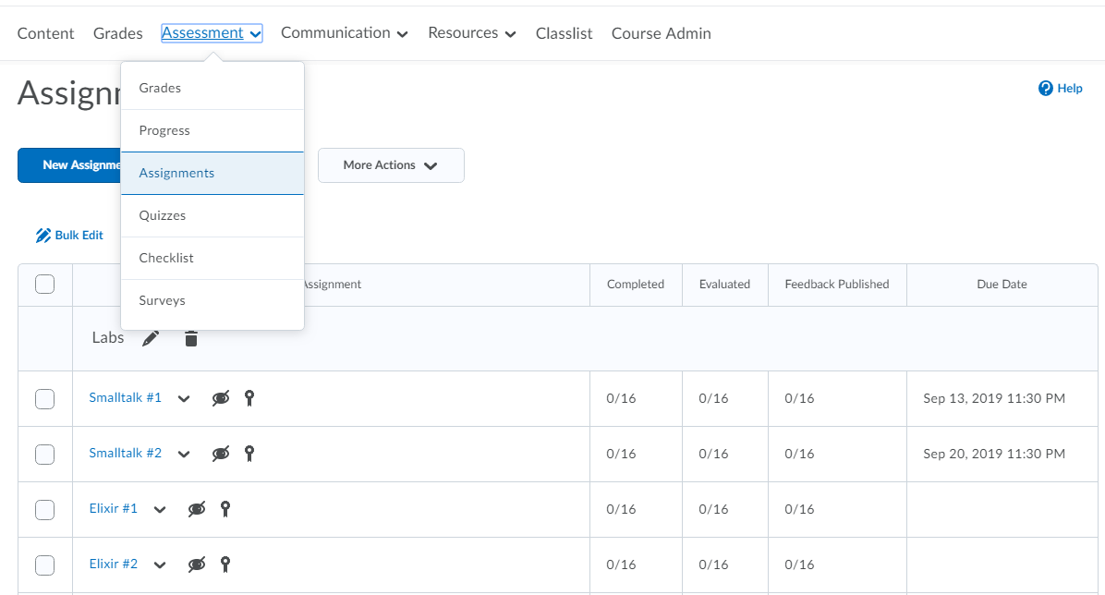
D2L Course Content

Slide 8

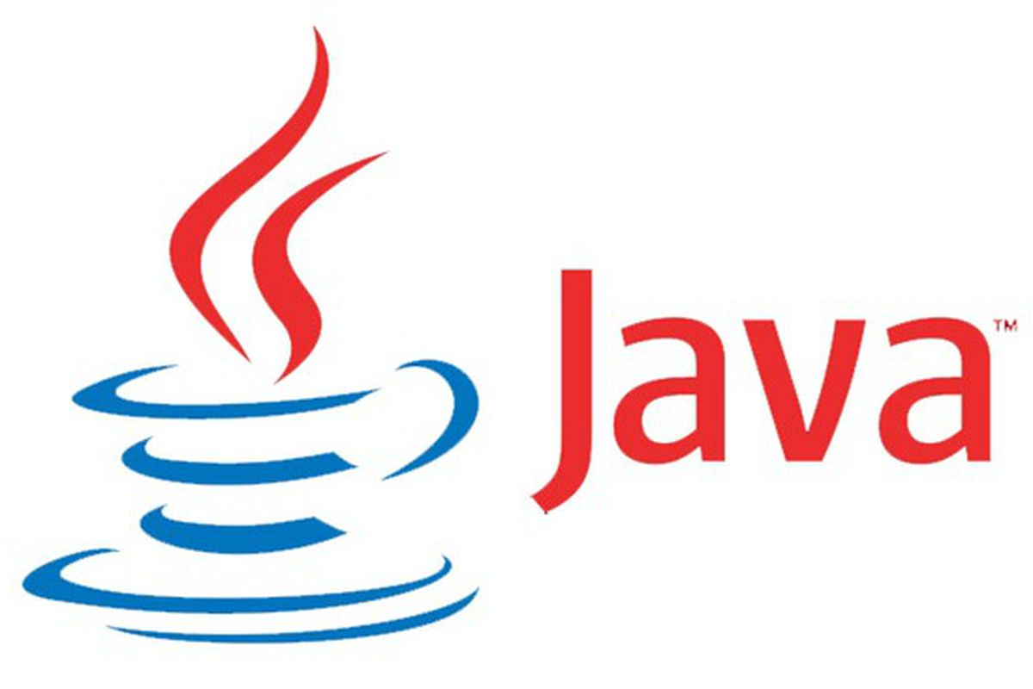

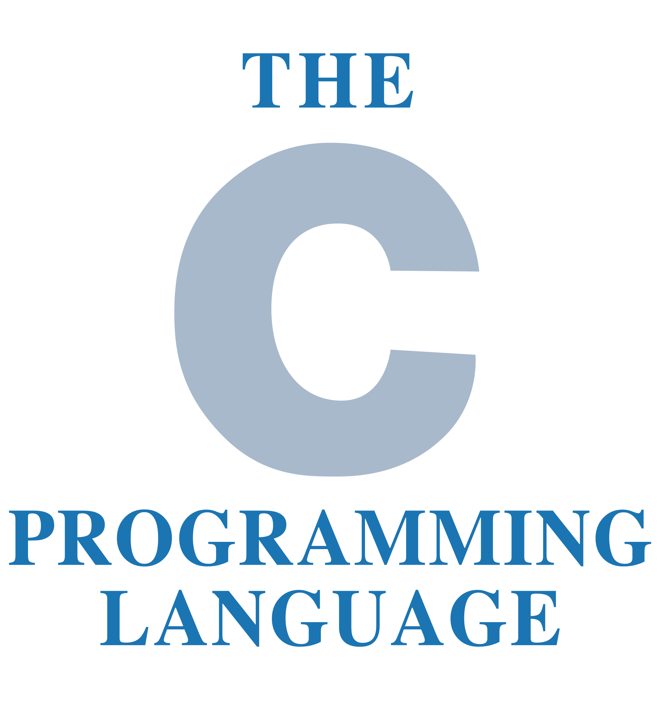
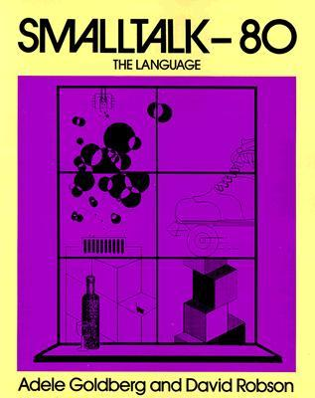


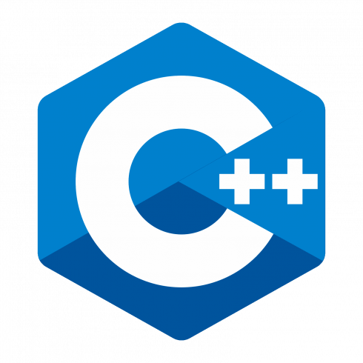
Course Synopsis
From the Chang School catalogue:
A survey of major programming paradigms, with emphasis on the functional paradigm. Discussion of data typing, program decomposition, scoping rules, control structures parameter passing. Programming languages will likely include commercially important functional languages such as Haskell, Clojure and Erlang, with examples of others as time permits.

Slide 9
Course Synopsis
Study fundamental concepts in the design of programming languages.
Explore through four languages: Smalltalk, Elixir, Haskell, and Rust.
Each of these differs in a number of significant language characteristics:
Type systems: static VS dynamic, strong VS weak typing
Paradigm: object oriented, functional, and imperative
Syntax and semantics: scoping rules, data types, control structures, subprograms, encapsulation, concurrency, and exception handling.

Slide 10
Language Learning Outcomes
For the languages we cover (Smalltalk, Elixir, Haskell, Rust):
Recognize code in the language
Describe the type system, precedence rules for expressions, etc.
Write code to define a function/method, conditionally evaluate expressions and statements, iterate/recurse, etc.
Trace the execution of a simple (10-20 line) program, predict output
Be able to understand and/or code a simple program with objects/functions/blocks as parameters

Slide 11
Course Text
No official text for this course. Save your money!
Lecture slides will be posted every week.
Online resources for each language will also be provided.

Slide 12

Evaluation
Midterm: 25% Class #6 (Oct 19)
Final: 35% Last class (Dec 7)
Labs: 20% 8 labs, two per language, 2.5% each
Assignments: 20% One per language, complete 2 of 4

Slide 13

Labs
Eight labs, first is today!
Saturday, 12-1pm (after class)
Attendance optional, submission mandatory.
Due Friday at 11:59pm each week a lab is given (on D2L).
Location? About that….

Slide 14
Labs…
The computer labs in ENG have been recently renovated.
Chang school students no longer have card access to the labs.
I highly recommend that students work on their personal computers or laptops for this course.
That being said, we do have ENG 201 booked from 12 to 1pm.
If you want to use the computer lab after class, let me know.

Slide 15
Tentative Content Schedule
First five weeks, Sept 7 – Oct 5:
Smalltalk, Elixir, assorted theory
Oct 12:
Reading week, no class
Oct 19:
Midterm, covers everything up to this point
Six weeks, Oct 26 – Nov 30:
Haskell, Rust, assorted theory
Dec 7:
Final exam. Covers everything, larger focus on Haskell and Rust

Slide 16

Any Questions?

Slide 17
Let’s Get Started!

Slide 18
Today
Imperative programming paradigm
Object Oriented Programming
The Smalltalk programming language
Lab #1

Slide 19


First, some inspiration:
"Measuring programming progress by lines of code is like measuring aircraft building progress by weight."
- Bill Gates
"Debugging is twice as hard as writing the code in the first place. Therefore, if you write the code as cleverly as possible, you are, by definition, not smart enough to debug it."
- Brian W. Kernighan (Bell labs)

Slide 20


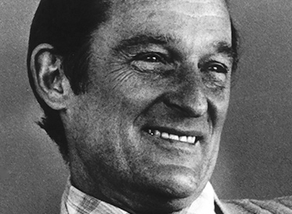

"Most of you are familiar with the virtues of a programmer. There are three, of course: laziness, impatience, and hubris."
- Larry Wall (Creator of Perl)
"Most software today is very much like an Egyptian pyramid with millions of bricks piled on top of each other, with no structural
integrity, but just done by brute force and thousands of slaves."
- Alan Kay (OOP pioneer)
"The trouble with programmers is that you can never tell what a programmer is doing until it’s too late."
- Seymour Cray (Father of supercomputing)

Slide 21
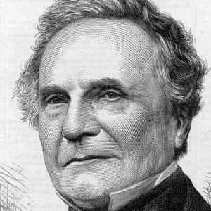
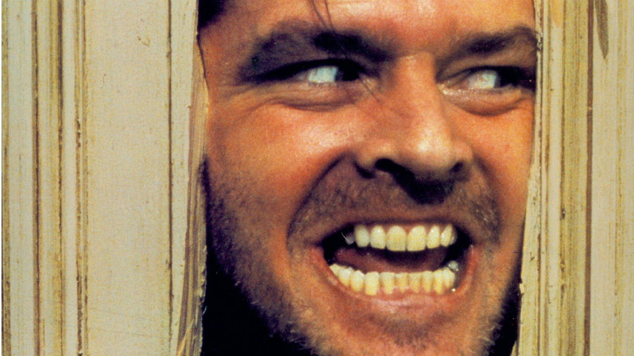

"On two occasions I have been asked [by members of Parliament]: ‘Pray, Mr. Babbage, if you put into the machine wrong figures, will the right answers come out?’ I am not able rightly to apprehend the kind of confusion of ideas that could provoke such a question."
- Charles Babbage (Analytical engine)
"Always code as if the guy who ends up maintaining your code will be a violent psychopath who knows where you live."
- Author disputed
"There are two ways of constructing a software design. One way is to make it so simple that there are obviously no deficiencies. And the other way is to make it so complicated that there are no obvious deficiencies."
- C.A.R. Hoare (Quicksort creator)

Slide 22
Imperative Language Paradigm

Slide 23
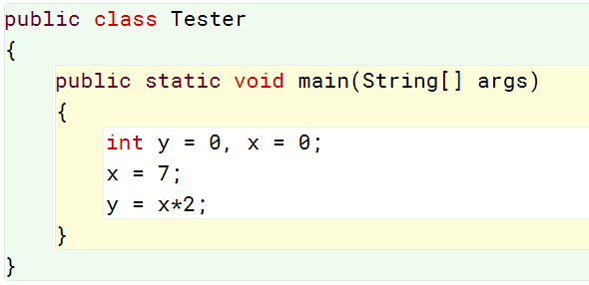
Imperative Language Paradigm
This is what you’re familiar with, assuming you’ve taken CCPS 109/209 (in Java)
Imperative programming uses statements to change a program’s state:
?
Statements

Slide 24
Program State
Programs store data in variables
Variables represent locations in the computer’s memory
The contents of memory in use by a program, at any given time during its execution, is called the program’s state.

Slide 25
Statements can cause a program to change state:
x y
State 1)
0 0
State 2)
7 0
State 3)
7 14
Fundamentally, everything is done by changing values of variables

Slide 26

Everyday Example?
State variables:
Channel
Volume
We must know the current state of the TV, or “Volume Up” and “Channel Down” can’t be properly defined.
Thus, current volume and current channel are part of the TV’s state.

Slide 27
Operating System Example
From CCPS 590
When an interrupt occurs, the state of the processor (accumulators, registers, etc.) is saved to memory.
When the interrupt is over, the state of the processor before the interrupt can be restored.

Slide 28

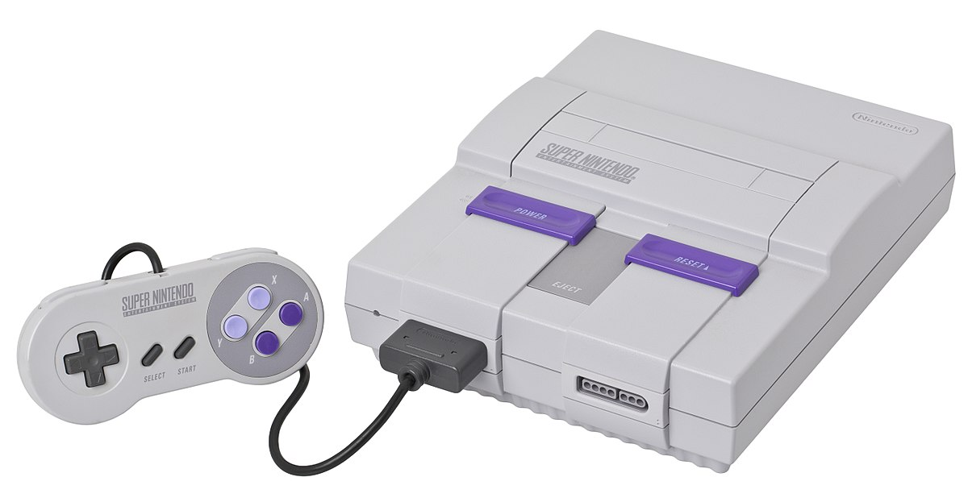
Emulator Save States
If you’ve ever played a console emulator with a “save state” option, this is how they work.
A save state is simply a memory dump of the console’s RAM.

Slide 29
Why Imperative?
Recipes, checklists, IKEA instructions, etc. are all familiar concepts.
These things are not computer programs, but are similar in style to imperative programming.
Understanding imperative programming is thus less of a conceptual leap for the novice programmer.

Slide 30
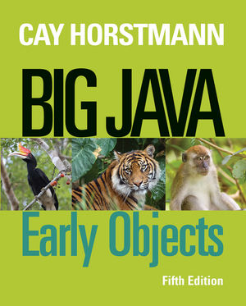
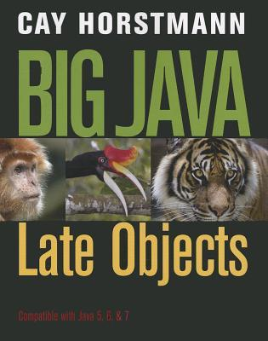
Evidence?
Before switching to Python, Ryerson taught multiple versions of CPS109:
Objects first (for people with programming experience)
Objects later (for people new to programming)
Begins straight away with OOP principles, objects and classes.
Focuses on imperative paradigm before introducing OOP abstraction

Slide 31
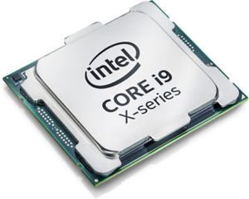
Why Imperative?
Machine code is imperative, and nearly all computer hardware is designed to execute machine code.
From this low level perspective, “state” can be described in terms of memory locations and machine instructions.
From a high level language perspective, state is described in terms of variables and more complex statements
In either case, the paradigm is the same.

Slide 32
In other words, we would want a good reason to seek an alternative to imperative programming.

Slide 33
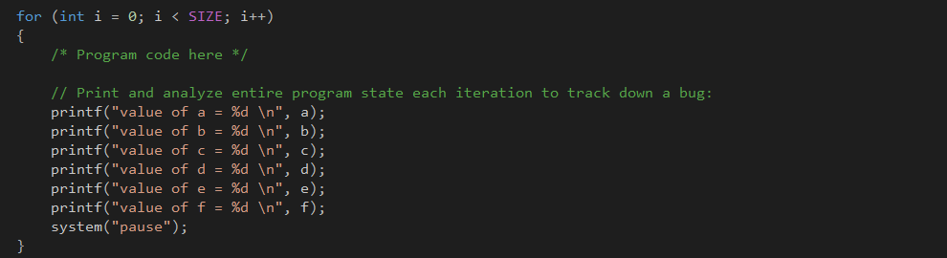
Imperative Drawbacks?
Fine for small programs, easy to keep track of a small number of variables.
Difficult to scale up, both in terms of code size and parallelism.
It gets very hard to model a program’s state in one’s head. This leads to convoluted debugging techniques:
C still dominates in embedded systems

Slide 34
Procedural Programming
State changes are localized (partially or entirely) to procedures (functions/subroutines).
Makes imperative programs far more readable, simplifies coding, and allows for code reuse between programmers.
In C, instead of having 1000 lines of code in our main() function, we keep main() as short as possible and add user-defined functions.

Slide 35
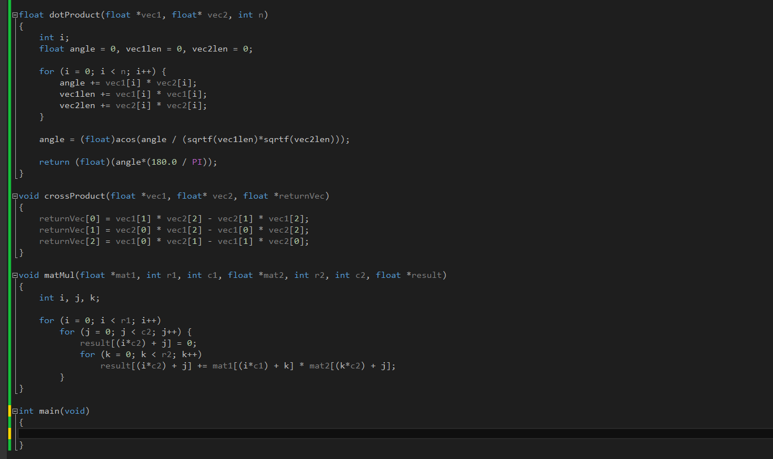
Example:
C doesn’t have native support for matrix operations.
We can write our own functions rather than duplicating code in our main()

Slide 36
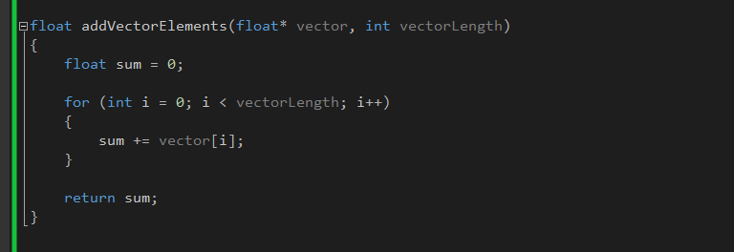
“Makes imperative programs far more readable, simplifies coding, and allow for code reuse between programmers.”
If procedures are well written, it is often possible to discern what a procedure does based solely on the name and parameter list.

Slide 37
In Summary
Imperative paradigm uses statements to change a program’s state.
The programmer specifies an explicit sequence of steps for the program to follow.
Adding procedures/functions/subroutines can improve scalability.
Code can be made more readable, less duplication, easier to reuse.
Principle of modularity – separate program functionality into independent, interchangeable modules.

Slide 38
Alternatives?
Two widely used paradigms:
Functional Programming:
Avoid changing state, avoid mutable data
Declarative rather than imperative
Tell the program where to go, not how to get there.
Object Oriented Programming:
“Pure” OO languages treat even primitives and operators as objects
Java/C++ and others support OOP to greater or lesser degrees.

Slide 39
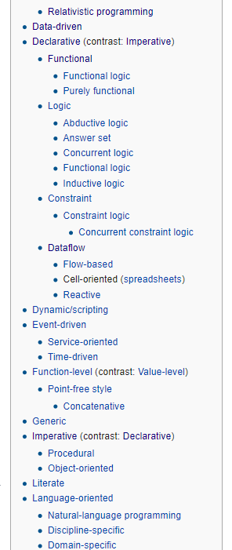
Going forward, always remember:
The line between different paradigms is grey.
Paradigms classify languages based on their features
Any given language can possess features from multiple paradigms and thus belong to all.
C is considered a very imperative language, but it supports first class functions through the use of function pointers.

Slide 40
Object-Oriented Programming (OOP)

Slide 41

Object-Oriented Programming (OOP)
“Object-oriented programming is an exceptionally bad idea which could only have originated in California.”
- Edsger Dijkstra

Slide 42
Objects?
Broadly speaking, a software construct that implements both state and behavior.
We can also say that objects have identity. Unique instances of the same class can exist simultaneously.
In Java, behaviors are implemented as methods, C++ as member functions. Same idea.
An object’s procedures can access and modify the data fields of that object.
In the OOP paradigm, programs are built up of objects that communicate with each other.

Slide 43
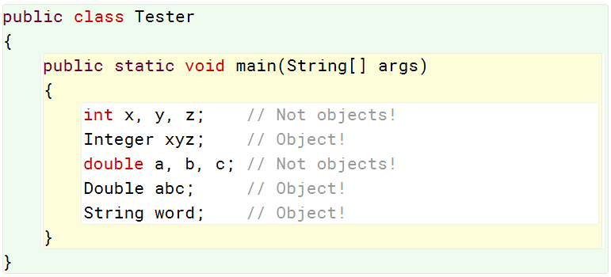
Objects
Broadly speaking, a software construct that implements both state and behavior.
These are primitives.
They have a state, but no associated behavior.
No associated methods.

Slide 44
Objects
Broadly speaking, a software construct that implements both state and behavior.
These are Objects.
They have both a state, and associated behaviors.
Behaviors implemented via class methods.

Slide 45
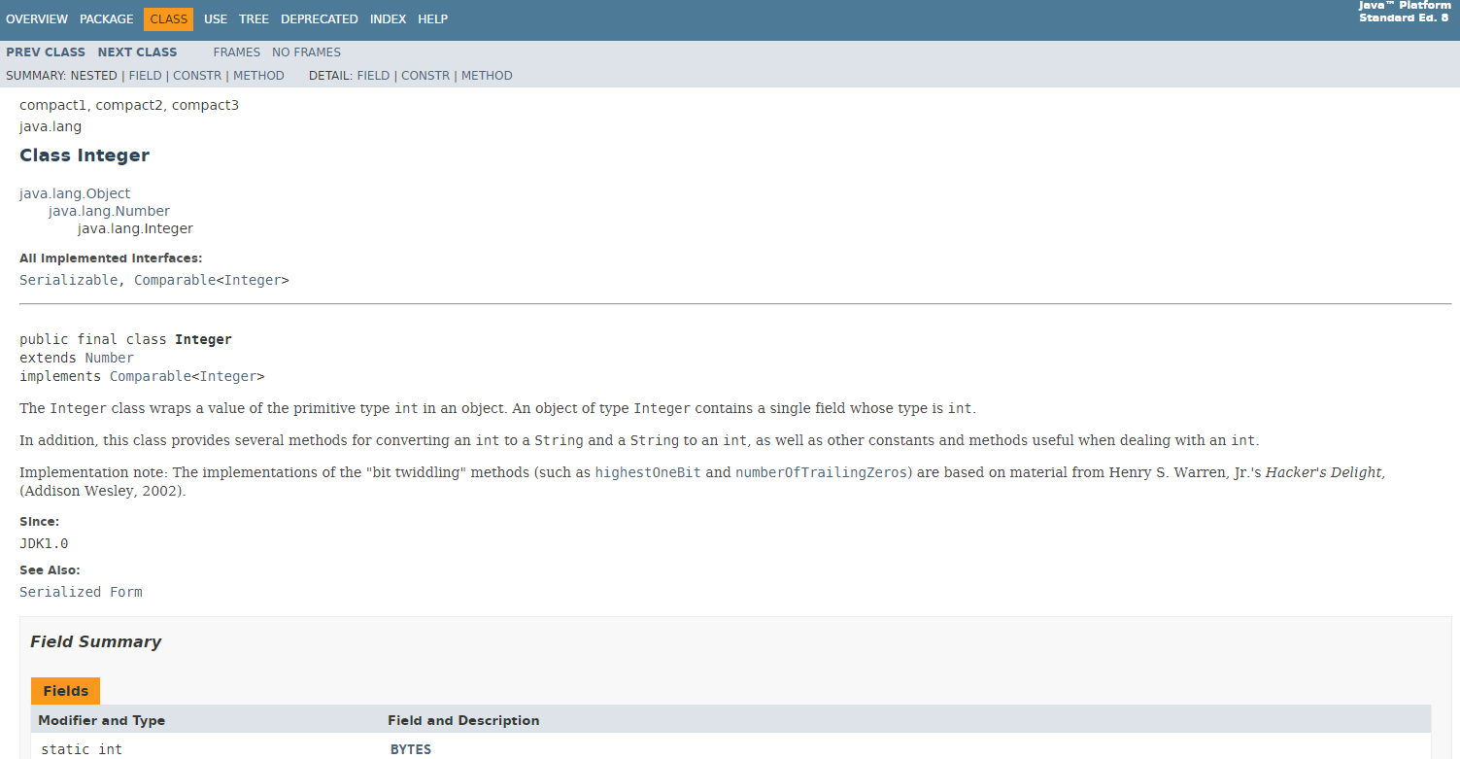

Slide 46
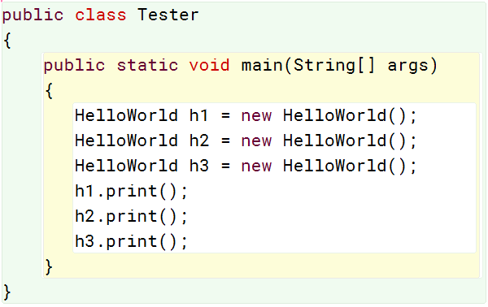
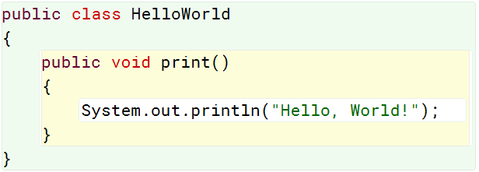
Class-Based OOP
Objects are instances of classes
The class is the cookie cutter, the object is the cookie.
Object instances
Class definition

Slide 47
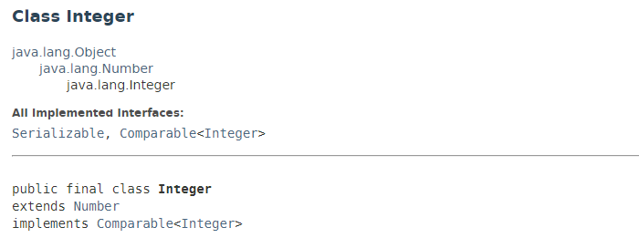
Class-Based OOP
Objects are instances of classes
The class is the cookie cutter, the object is the cookie.
OOP languages typically support notions of inheritance.
Integer inherits from Number
Number inherits from Object.

Slide 48
OOP: In Summary
Programs are built up of objects that communicate with each other.
Objects combine attributes (data, variables) and procedures (functions, methods).
Most common are class-based OOP languages (C++, Java). Objects are instances of classes (contrast with prototype-based).
Ideas like inheritance provide code reusability.
OOP languages are still largely imperative.
Class methods can implement behaviors, providing abstraction.

Slide 49
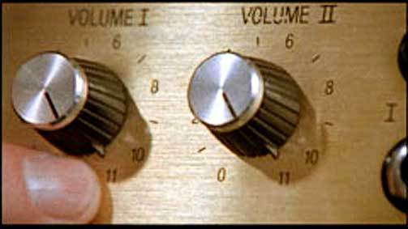
Smalltalk: OOP cranked up to 11
But first…

Slide 50
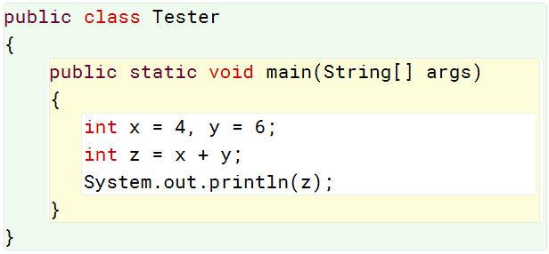
Syntax
The externally visible representation of a program
Based on sequence of characters (text-based languages)
Easily understood in the context of a syntax error:
This Java code is syntactically correct.
We know this because it compiles.
The sequence of characters that comprise the source code make sense in the context of the Java language.

Slide 51
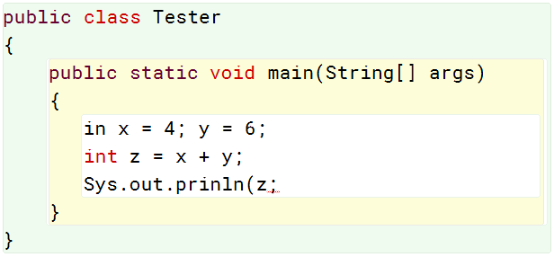
Syntax
The externally visible representation of a program
Based on sequence of characters (text-based languages)
Easily understood in the context of a syntax error:
This Java code contains syntax errors. It does not compile.
The sequence of characters that comprise this source code does NOT make sense!

Slide 52
Simplicity - How much to learn:
Size of grammar. How “much” syntax is there?
Complexity of navigating modules or classes
Complexity of type system (how many types?)
A few more things relating to syntax…
Orthogonality - How hard to learn, how do features interact:
Number of special syntax forms, how many ways can we combine grammar elements
Number of special data types
Type system overall (static, dynamic)
Extensibility:
Do mechanisms exist to extend the language?
Functionally, syntactically, defining literals, overloading, etc.

Slide 53
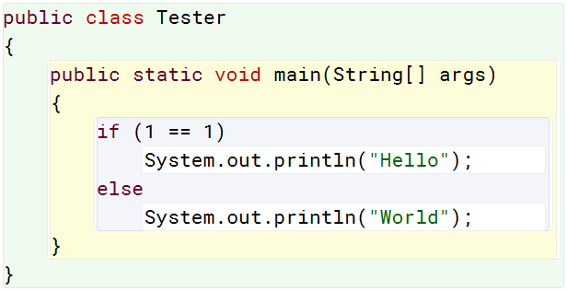
Semantics
If syntax is the form, semantics is the meaning. What does the code actually do?
Can be understood by showing relationship between input and output
Code can be syntactically correct but have an unclear meaning.
This code is syntactically correct.
Semantically, it is somewhat confusing.

Slide 54
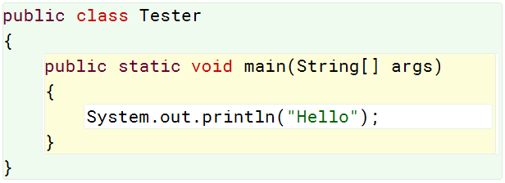
This code is syntactically correct.
Semantically, it is somewhat confusing.
Semantically, It is exactly the same as:
1)
An understanding of a language’s semantics allows us to look at 1), and understand it as being the same as 2)
Leads to more efficient machine code.
2)
“A compiler will complain about syntax, your coworkers will complain about semantics”

Slide 55
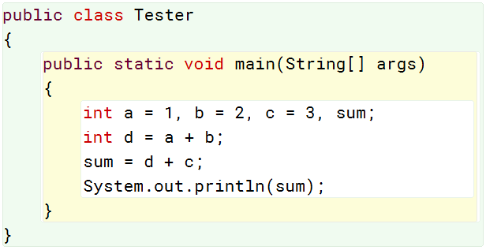
Pragmatics
What is a particular language construct can be used for.
Consider the assignment operator (=):
Initialize variables with constants
Initialize variable with result of sum of two other variables.
Store sum of two variables in a variable
However! The assignment operator can’t typically be used to clone arrays/objects.

Slide 56
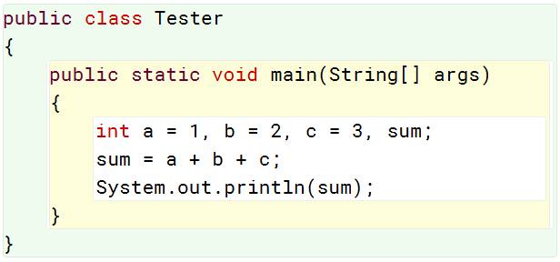
Implementation
A particular set of pragmatics that makes a program executable
Multiple unique implementations can solve the same problem
These implementations are slightly different, but solve the same problem of summing three numbers and printing the result.

Slide 57
Programming Language Characteristics
Syntax – Language form:
Simplicity, how much to learn
Orthogonality, how hard to learn, how do features interact
Extensibility, can the language be extended by the programmer
Semantics – Language meaning:
What does a block of code actually do/mean
Pragmatics:
What can a particular language construct be used for.
Implementation:
A particular set of pragmatics that makes a program executable

Slide 58
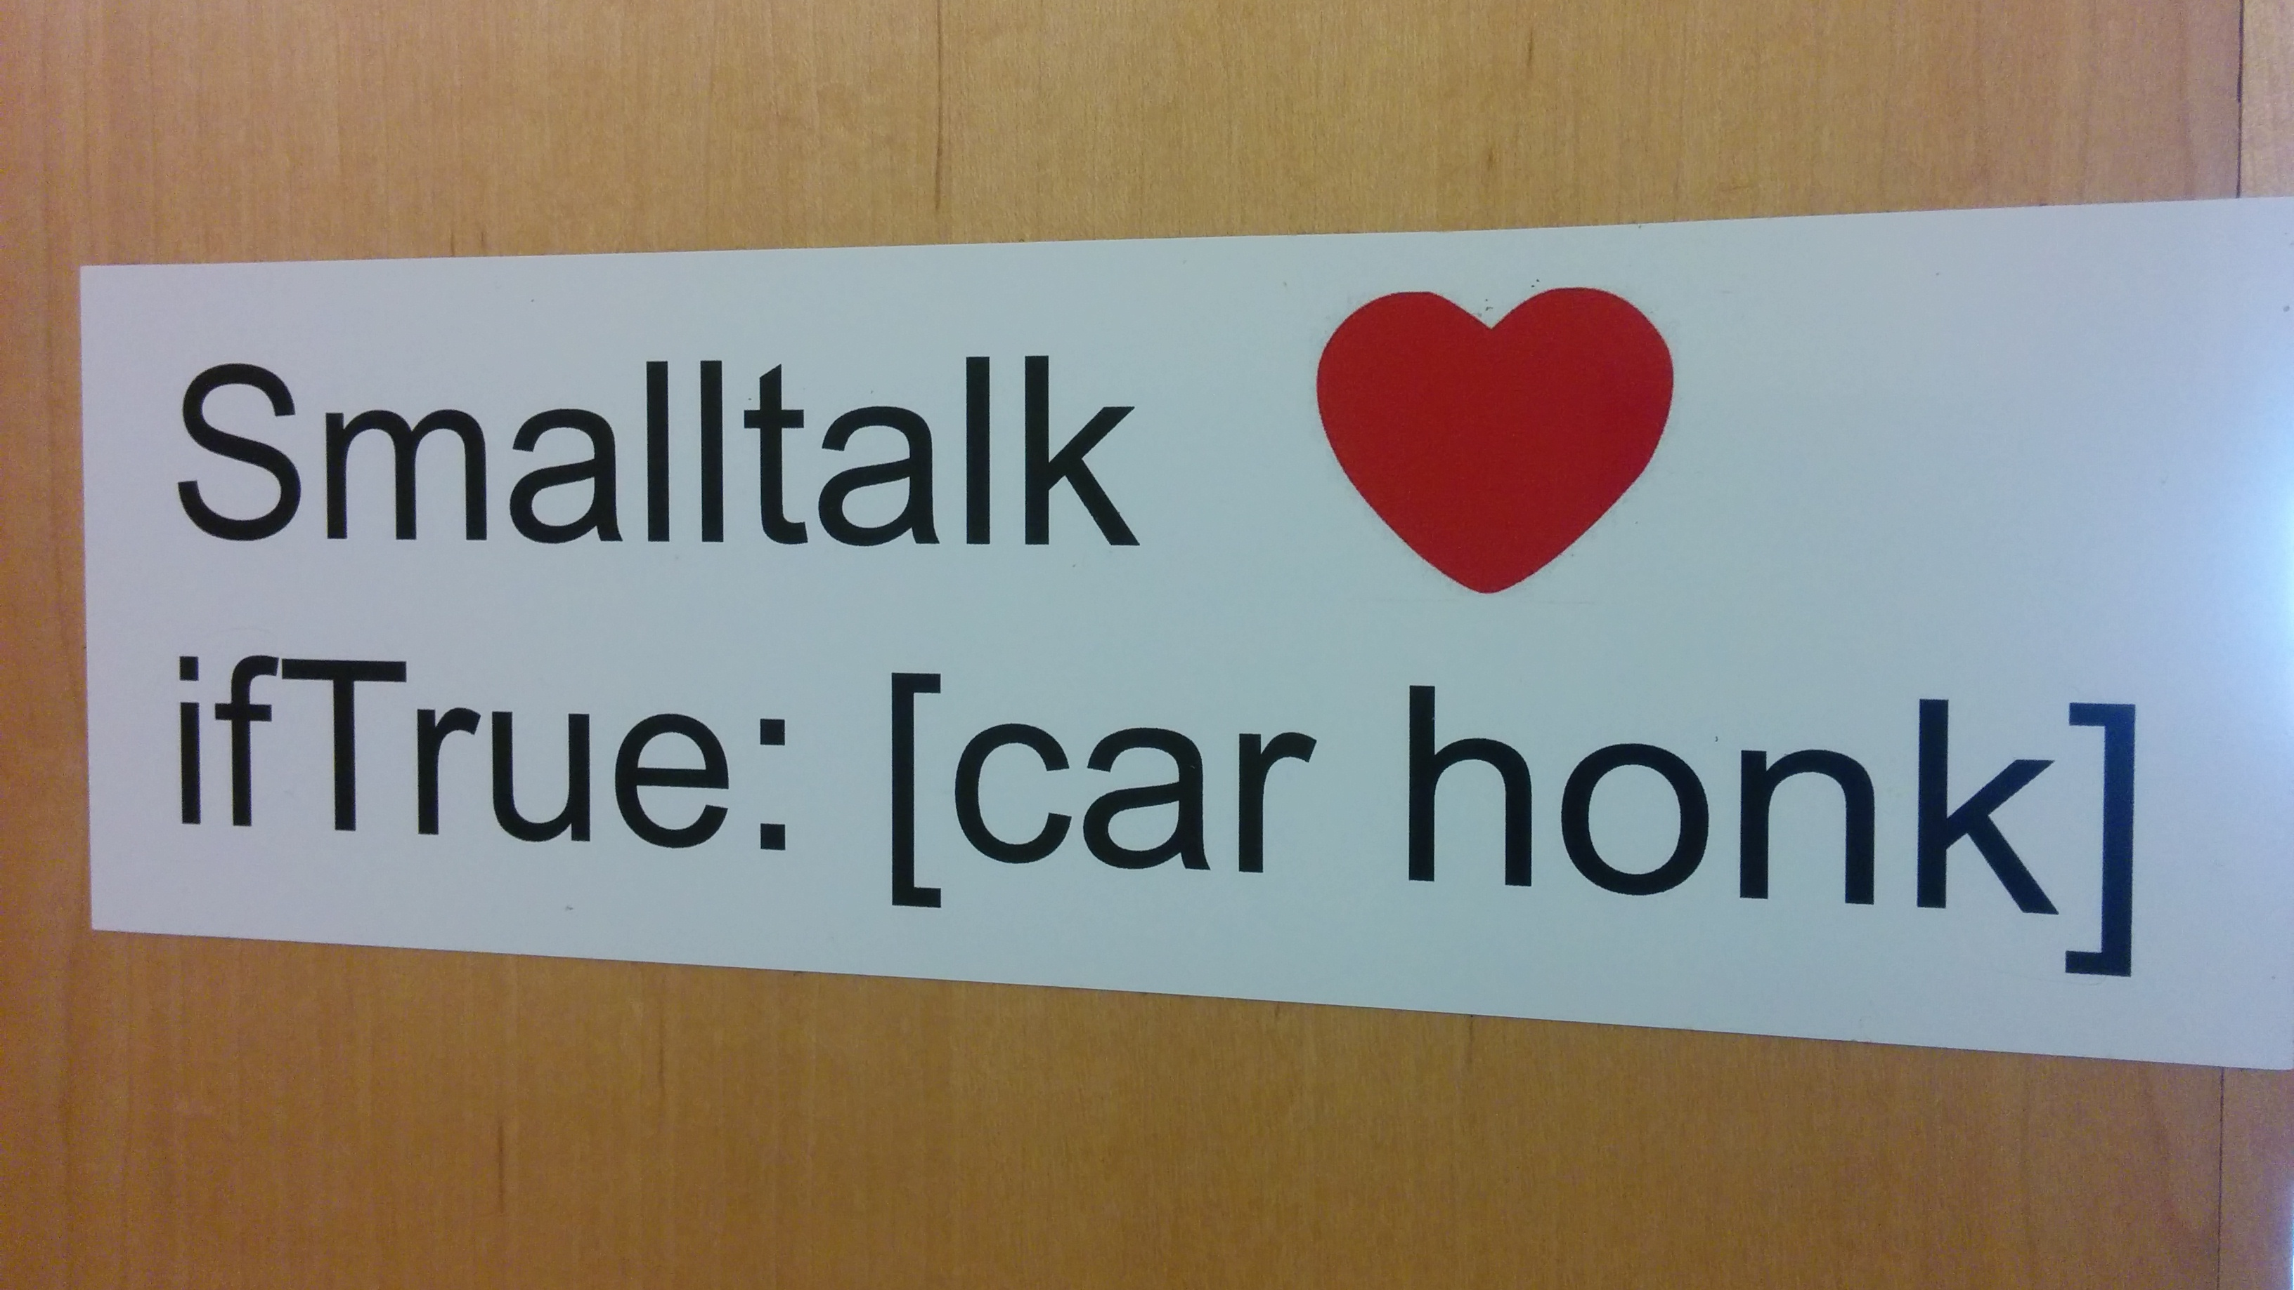

Slide 59
History:
“Smalltalk” typically refers to Smalltalk-80, first publicly available version (1980)
However, first version was Smalltalk-71
Developed by Alan Kay at Xerox PARC
"Most software today is very much like an Egyptian pyramid with millions of bricks piled on top of each other, with no structural
integrity, but just done by brute force and thousands of slaves."
- Alan Kay (OOP pioneer)

Slide 60
History:
“Smalltalk” typically refers to Smalltalk-80
However, first version was Smalltalk-71
Developed by Alan Kay at Xerox PARC
Created in a few mornings of work, supposedly on a bet.
Smalltalk-72 was more full-featured, and used for research at Xerox PARC
Smalltalk-76 was the result of significant performance-enhancing revisions
Smalltalk-80 V1 was given to select companies for peer review
Smalltalk-80 V2 was released to the public in 1983.

Slide 61
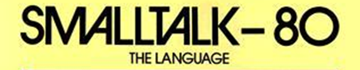
Overview
Smalltalk is the prototypical class-based, object-oriented language.
Its syntax is very minimal
There are no primitives:
No int x, double y, etc.
Control structures are methods:
No if/else/while/for constructs, etc. Weird, but true!
Objects are central – Unlike Java and C++, there are no primitives. Everything is an object.
Pure object-oriented.

Slide 62

Pure Object-Oriented
Everything is an object. Everything is an instance of a corresponding class. Recall cookie/cookie cutter analogy.
Class-based. Every object has a class that defines the structure of that object
Classes (the cookie cutter!) themselves are also objects.
Each class is an instance of the metaclass of that object.
Each metaclass is an instance of a class called Metaclass
Your brain right now:

Slide 63
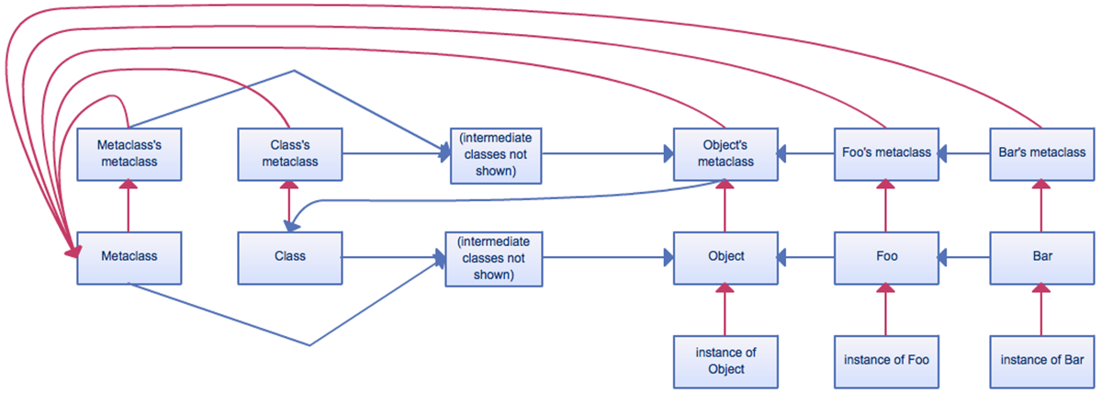
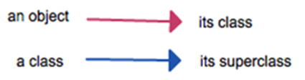
Classes (the cookie cutter!) themselves are also objects.
Each class is instance of the metaclass of that object.
Each metaclass is an instance of a class called Metaclass

Slide 64
Objects in Smalltalk
Everything is an object. Everything is an instance of a corresponding class.
A Smalltalk object can do exactly three things:
Hold state (assignment)
Receive a message (from itself or another object)
Send message (to itself or another object)
Message passing is central in Smalltalk. We’ll spend plenty of time on it.

Slide 65
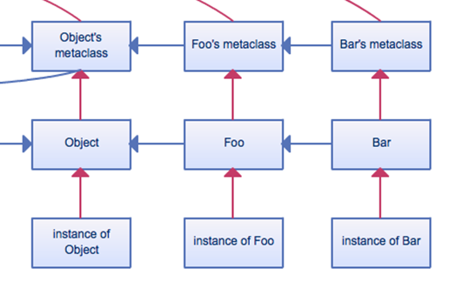
Message Passing
Passing a message to an object is semantically similar to invoking its methods:
When a message is sent to an object:
Search the object’s class for an appropriate method to deal with the message.
Not found? check superclass (inheritance!)
Repeat until method is found, or we hit class “Object”. Much like Java.
Still not found? Throw exception.

Slide 66
Message Passing
Message passing drives all computation in Smalltalk.
For every snippet of Smalltalk code we see, look at it in terms of message passing.
What messages are being sent? What objects are they being sent to?
Understand message passing, understand Smalltalk.

Slide 67
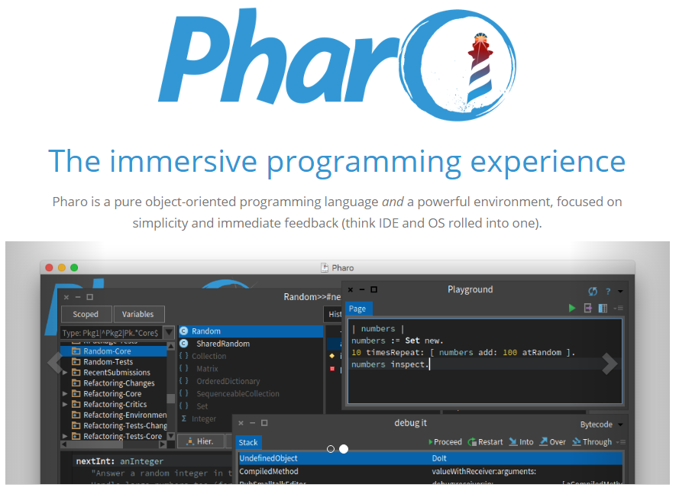
https://pharo.org/

Slide 68
Pharo is a GUI-based programming environment for the Smalltalk programming language.
Smalltalk is based on a virtual machine, similar to Java, which interprets bytecode and makes it platform independent.
One of the unique features of Smalltalk is that all development and changes are done in the Smalltalk environment itself.
All classes (including their code) and objects (including their state) are stored inside an image that encapsulates the complete state of the system.
When you save the image, close the VM, and then re-open it again, perhaps on another machine, everything will be exactly as you left it.

Slide 69
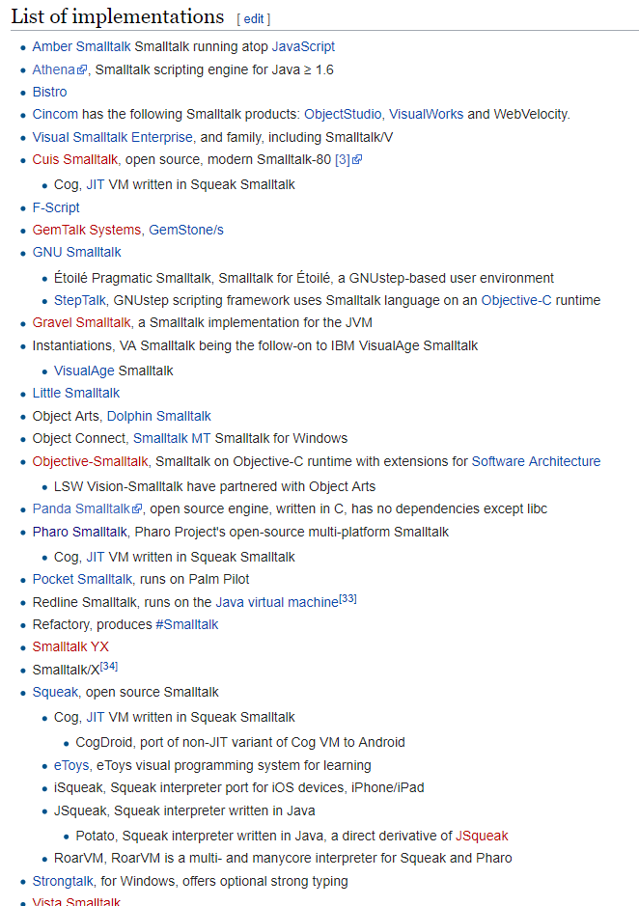
By the way, there are many different Smalltalk implementations.
They are all similar, but each may have subtle differences in their syntax and major differences in their class organization.
When/if Googling for help, it’s useful to specify the specific implementation (Pharo for this course).

Slide 70
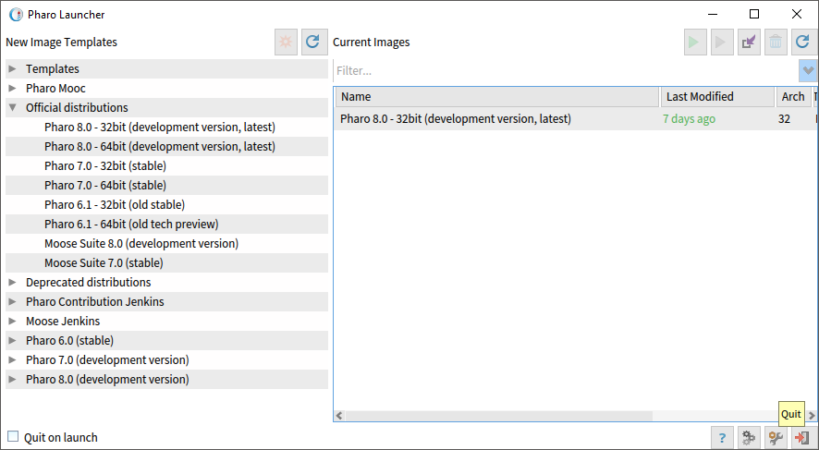
Pharo: Smalltalk IDE
Pharo Launcher:
Pick a distribution, download it, launch it.
Everything we do in class will be in 8.0, 32-bit

Slide 71
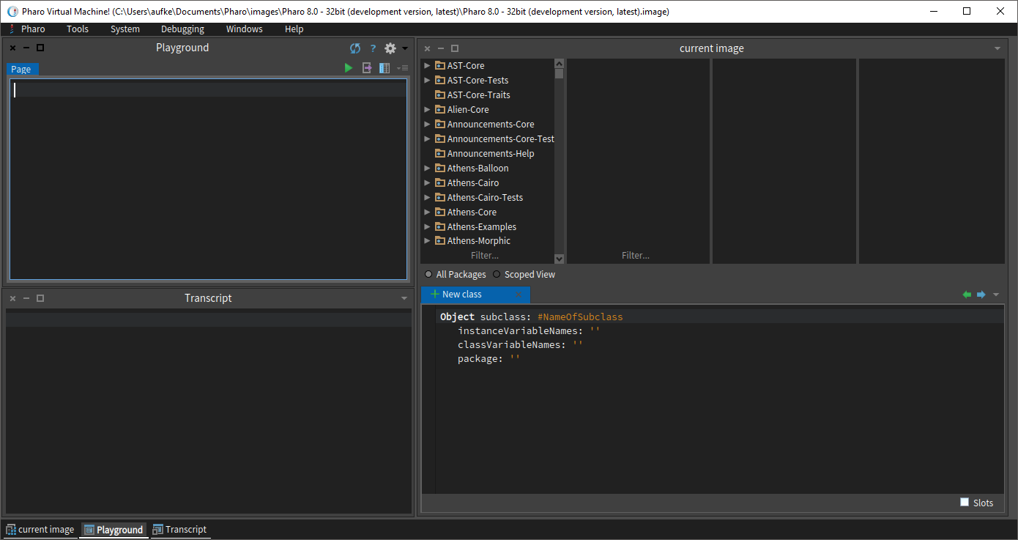
Class browser:
Here we can browse the entire Smalltalk class hierarchy
We can also add and edit our own custom classes here
Playground window:
Smalltalk code goes here
Transcript window:
Output is printed here
Class implementation can be viewed and modified here

Slide 72
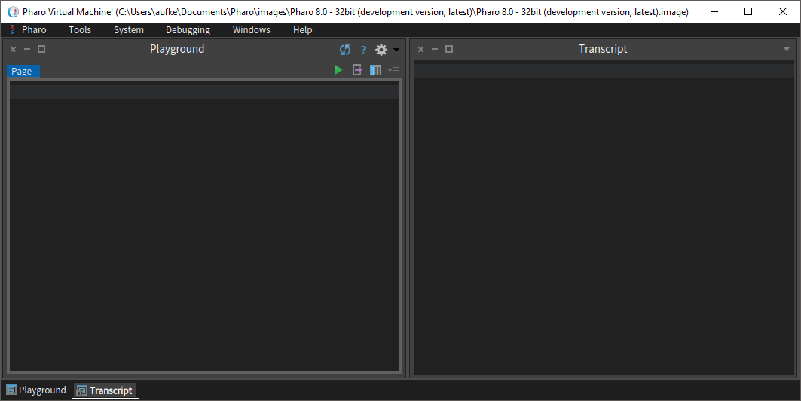
Pharo: Smalltalk IDE
We’ll typically keep the class browser collapsed for our in-class examples

Slide 73
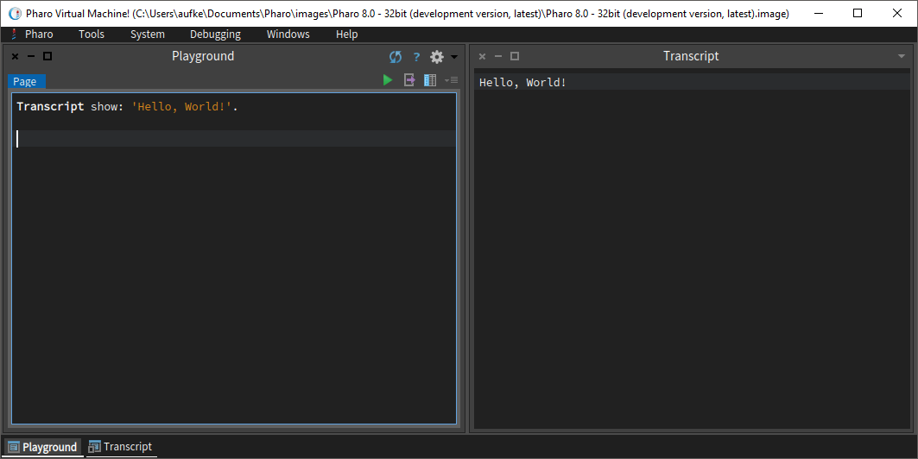
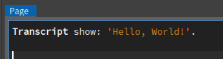
Hello, World!
We are passing the show: message to the Transcript object.
This message includes one argument, a string literal ‘Hello, World!’

Slide 74
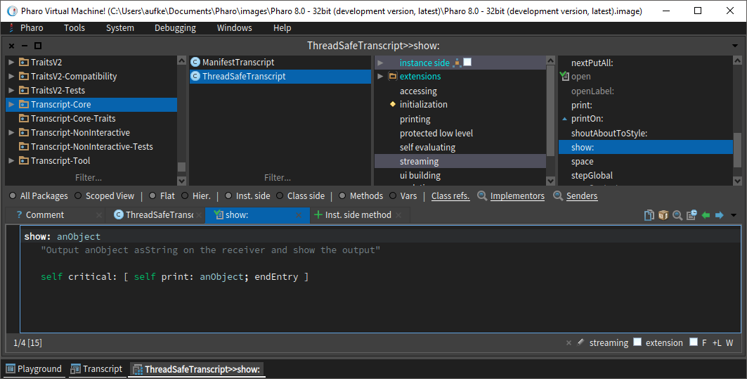
Transcript show:

Slide 75
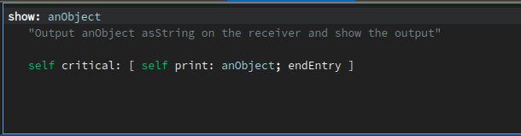
Transcript show:
Method name and parameter
Same as this in Java

Slide 76
Nifty Pharo Reference:
http://files.pharo.org/media/pharoCheatSheet.pdf
Nifty Squeak Reference:
http://squeak.org/documentation/terse_guide/
Squeak is a different Smalltalk implementation.
Most of the syntax is the same, and this terse guide is very conveniently laid out as a reference to use while coding.

Slide 77
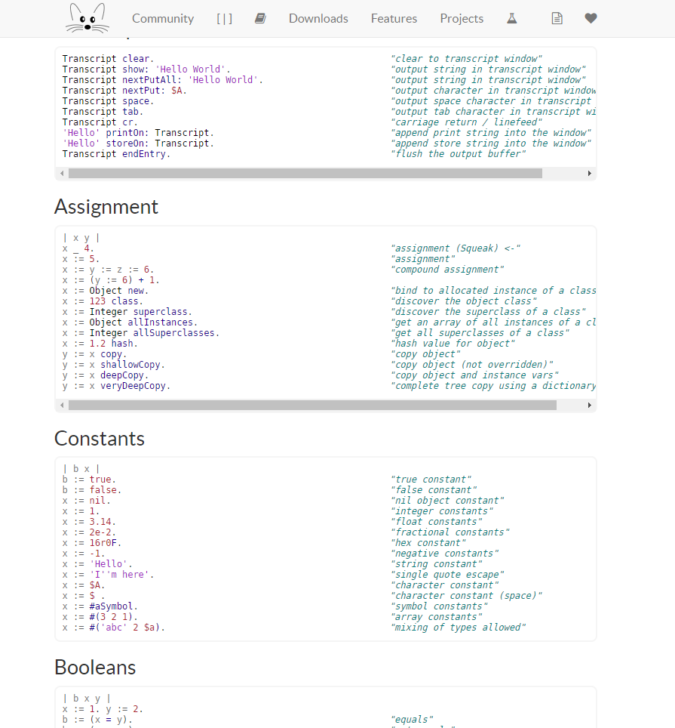

Slide 78
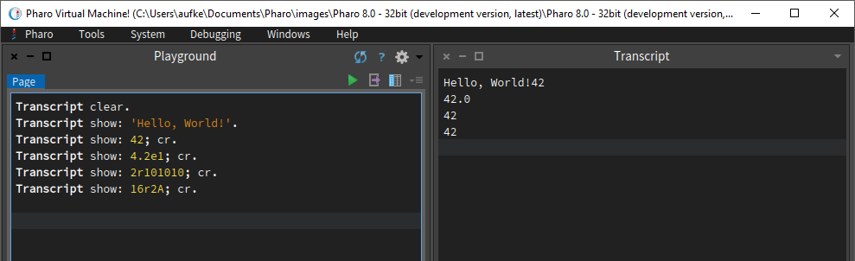
Smalltalk Syntax
Extremely minimalist:
Smalltalk syntax famously fits on a postcard
Scientific notation
Binary
Hexadecimal
Literals:
42, -42, 123.45, 1.2345e2, 2r10010010, 16rA000
Dot separates Smalltalk statements
Semi-colon allows us to cascade multiple messages to Transcript
cr is the code for carriage return (newline)

Slide 79
Smalltalk Syntax
Extremely minimalist:
Smalltalk syntax famously fits on a postcard
Literals:
42, -42, 123.45, 1.2345e2, 2r10010010, 16rA000
Characters – denoted by a $ (rather than single quotes)
$A, $8, $?
Strings – denoted with single quotes:
‘Hello, World!’
Comments are enclosed in quotes:
“This is a Smalltalk comment”

Slide 80
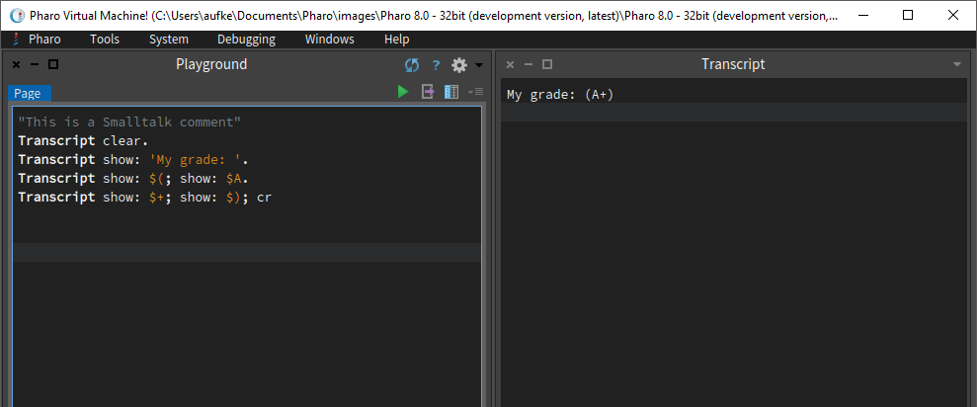
Literals:
Characters – denoted by a $ (rather than single quotes)
$A, $8, $?
Notice: We’re cascading two show: messages, each with an argument, and finally a carriage return

Slide 81
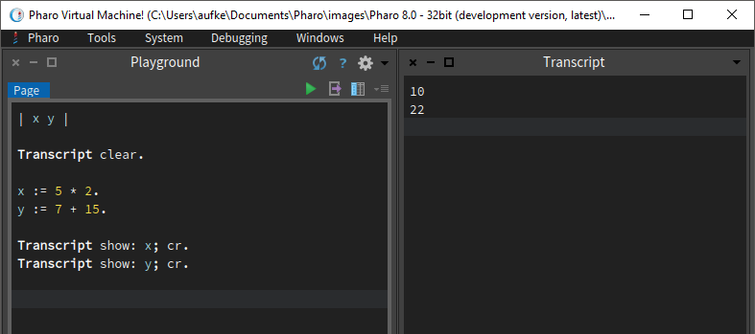
Smalltalk Variables
Must be declared before use (of course)
Variables are references to objects.
Most commonly used are instance and temporary variables
Temporary variables declared inside vertical bars: | x y |
Temporary variables declared at the top!
Arithmetic!
Operators mean what we’d expect.
Plus is addition, asterisk is multiplication, etc.
Assignment is done using :=

Slide 82
More Literals
Symbols:
# followed by string literal
#‘aSymbol’ same as #aSymbol (no whitespace, quotes implied)
#‘symbol one’ #‘symbol two’
Symbol objects are unique. Strings are not.
Meaning:
Two identical strings can be exist as two separate objects
For every unique symbol value, there can be only one object.

Slide 83

Variables a and b might reference different objects, despite the fact that the string literals are exactly the same.
Variables x and y reference the same object. There can be no two equal symbols which are different objects.
Let’s prove it!

Slide 84

Same value, different object!
Declare two identical strings, but in different ways to ensure we get different objects.
Compare strings. ‘=‘ checks for same value, ‘==‘ checks if they are the same object.

Slide 85

Same value, same object!
Symbol concatenation returns a string
Pass the asSymbol message to a string to convert it to a symbol.

Slide 86
Symbols: What’s the point?
Checking for equal string value involves comparing individual characters.
This can be costly if the strings are long. Linear time operation.
Checking if two variables reference the same object is fast – single integer comparison.
With symbols, if they reference different objects they have different values. The same cannot be said of strings.

Slide 87

More Literals
Arrays of literals:
#(1 2 3 4 5) Array of integers, numbers separated by spaces
#(1 2.0 #aSymbol ‘Hello’)
Array of anything and everything, heterogeneous
Smalltalk knows how to print an entire array
What about accessing individual elements?

Slide 88

Accessing Array Elements
Use at: message with single argument indicated index
Based on what is printed, we see that indexing in Smalltalk starts at 1!
Brackets here are simply enforcing precedence

Slide 89

Accessing Array Elements
Use at: keyword with single argument indicated index
Based on what is printed, we see that indexing in Smalltalk starts at 1!
Don’t go out of bounds. Runtime error.

Slide 90

Summary: Literals

Slide 91

Arithmetic Expressions

Slide 92

VS.
Arithmetic is largely the same in every language. Math is math.
So far, this is typical
Notice integer operations produce integer results

Slide 93


Division
Division is a coin toss. Truncate? Convert to float?
Smalltalk has a fraction type!
When we force the result to be integer, it truncates

Slide 94


Operator Precedence

Slide 95

Operator/Message Precedence
Three levels! Unary -> Binary -> Keyword
After that, ordering goes from left to right
Brackets must be used to specify ordering outside of this.
+ and * are both binary operators (two operands)

Slide 96

New or Differing Operators
// Integer division
\\ Integer remainder (% in Java)
sqrt Square root
raisedTo: Power function (pow() in Java)

Slide 97


… and much, much more:
http://squeak.org/documentation/terse_guide/

Slide 98

Different from what we’re used to:
x = Math.sqrt(25);
y = Math.pow(8, 2);

Slide 99


Slide 100
Recall:
Everything is an object. Everything is an instance of a corresponding class.
A Smalltalk object can do exactly three things:
Hold state (assignment)
Receive a message (from itself or another object)
Send message (to itself or another object)
Programs in Smalltalk are all about sending messages between objects

Slide 101
Recall:
Everything is an object. Everything is an instance of a corresponding class.
When a message is sent to an object:
Search the object’s class for an appropriate method to deal with the message.
Not found? check superclass (inheritance!)
Repeat until method is found, or we hit class “Object”. Much like Java.
Still not found? Throw exception.

Slide 102
Messages in Smalltalk
Think of every Smalltalk statement in terms of message passing:
x := 16 sqrt.
Only 3 operations:
Assignment
Send message
Receive message
The message sqrt is sent to the object 16
16 is an instance of the SmallInteger class.
SmallInteger handles the message (if it knows how)
Returns the result of the square root (in this case 4)
4 is an object!

Slide 103
Messages in Smalltalk
Think of every Smalltalk statement in terms of message passing:
x := 16 sqrt.
Only 3 operations:
Assignment
Send message
Receive message
Result assigned to x
16 is an instance of the SmallInteger class.
SmallInteger handles the message (if it knows how)
Returns the result of the square root (in this case 4)
x now references the result – a SmallInteger object, 4

Slide 104
Messages in Smalltalk
Think of every Smalltalk statement in terms of message passing:
x := 16 sqrt.
sqrt is a unary message:
It involves only one object
Remember our precedence rules: Unary -> Binary -> Keyword

Slide 105
Messages in Smalltalk
x := 2 raisedTo: 4.
2 is the receiving object
raisedTo: is the message
4 is the argument
This is called a “keyword” message
Remember our precedence rules: Unary -> Binary -> Keyword

Slide 106
Multiple Arguments
x := ‘Hello’ indexOf: $o startingAt: 2.
The actual message is indexOf:startingAt:
Smalltalk interleaves arguments.
Meant to improve readability.

Slide 107
Multiple Arguments
Don’t be confused!
x := ‘Hello’ indexOf: $o startingAt: 2.
Consider the following Java-like statement:
x = new Rectangle(200, 100);
In Smalltalk, this might be written as:
x := Rectangle width: 200 height: 100.

Slide 108
Binary Messages
x := 3 + 4
The message + is passed to object 3 with the argument 4
These behave similarly to keyword messages, with one key difference…
Binary messages are strictly between two objects. Typically arithmetic operators.
Keyword messages can contain any number of arguments.
Keyword messages include a colon. Quick and easy way to differentiate.

Slide 109
Messages are Symbols!
A message in Smalltalk is a symbol (unique character string)
In Java or C++, you cannot invoke class methods that don’t exist. This is a syntax error.
In Smalltalk, you can send any message to any object. If the object doesn’t know what to do with the message, a run-time error occurs.

Slide 110


In Smalltalk, you can send any message to any object. If the object doesn’t know what to do with the message, a run-time error occurs.
Symbol!
Send message blahblah to SmallInteger object 3.

Slide 111

Everything is an Object
Use the class message to print the class of any object:

Slide 112

Everything is an Object
Down the rabbit hole:
Metaclass of SmallInteger
Classes (the cookie cutter!) themselves are also objects.
Each class is instance of the metaclass of that object.
Each metaclass is an instance of a class called Metaclass

Slide 113
Message Summary
Unary Messages:
sqrt, squared
asInteger
class, cr
floor, ceiling
sin, cos, tan
Any message without argument(s)
Binary Messages:
+, -, *, /
//, \\
=, ==,
<, <=, >, >=
Arithmetic, comparison, etc.
Keyword Messages:
raisedTo:
bitAnd:, bitOr:
show:
ifTrue:ifFalse:
Message with one or more arguments, ending in semicolon:
http://squeak.org/documentation/terse_guide/

Slide 114
Example: What is the Result?
Which messages are unary? Binary? Keyword?
3 factorial + 4 factorial between: 10 and: 100
factorial gets sent to 3, then 4.
6 + 24 between: 10 and: 100
+ is sent to 6 with 24 as argument
30 between: 10 and: 100
between:and: sent to 30 with 10 and 100 as arguments
true

Slide 115


Slide 116

Classes

Slide 117

It’s recursive!
We can see everything in the System Browser.
All classes, all methods, everything.
Here is the factorial method defined in the Integer class.

Slide 118
Be VERY careful fooling around in here!
You can change the behavior of built-in Smalltalk methods.
Pharo itself is executing these methods live.
You can corrupt your Pharo image itself if you modify them.

Slide 119

Let’s create our own class:
Right-click in class category list, select “New package”

Slide 120


Slide 121

Select your new package
Under “New class” is a class template
Give your subclass a catchy name
Ctrl-S to save

Slide 122

We can add instance or class methods/variables

Slide 123

Let’s create a new instance method:

Slide 124

Keyword message, one argument
One temporary variable
^ used to return object
Ctrl-S to save

Slide 125

We didn’t implement a new method
Lab1 inherits it from Object

Slide 126
Summary
Imperative programming paradigm
Object Oriented Programming
Smalltalk:
Objects, literals
Arithmetic
Message Passing
Creating your own classes and methods in Pharo

Slide 127
Lab 1 is posted on D2L

Slide 128

Next week…
Blocks & more
(The fun stuff!)

